Slide 1
Hallucination Room
Marines Corps
CS 6334.001-Virtual Reality Project Presentation
Wenlong Yang wxy200000@utdallas.edu
Zilong Wang zxw200004@utdallas.edu
Minqing Yang mxw200004@utdallas.edu
Yulang Wu yxw126030@utdallas.edu

Slide 2


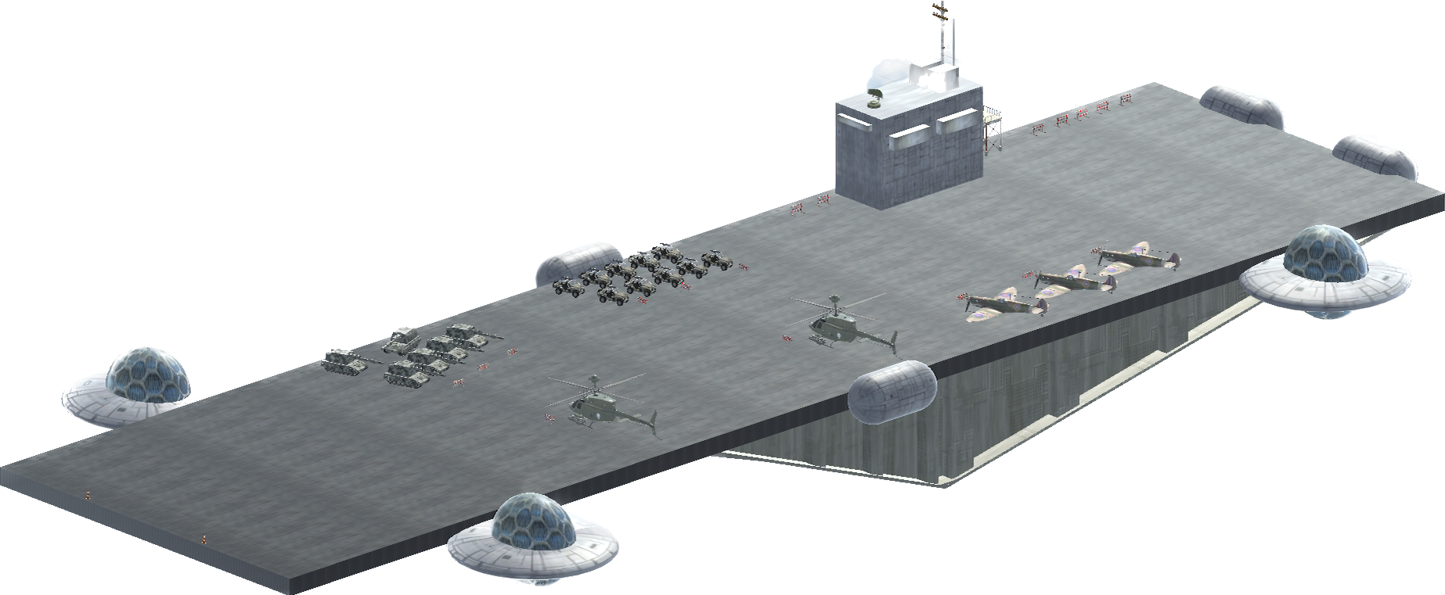
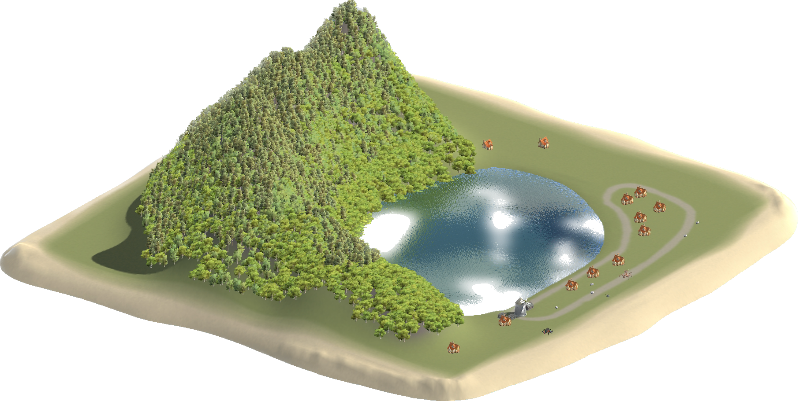

Background
Sky Carrier

Slide 3
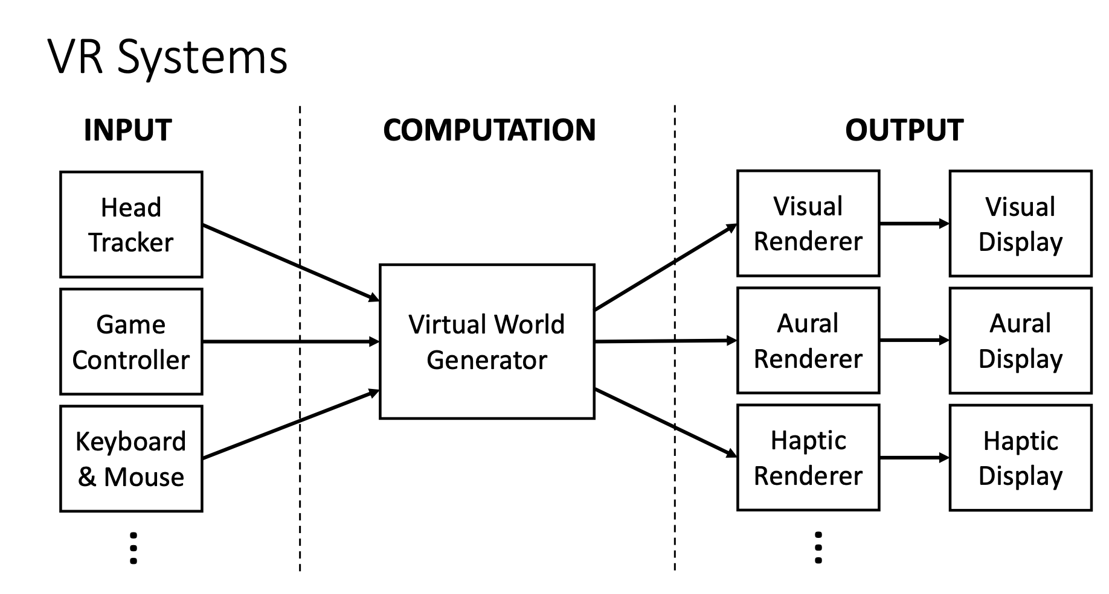
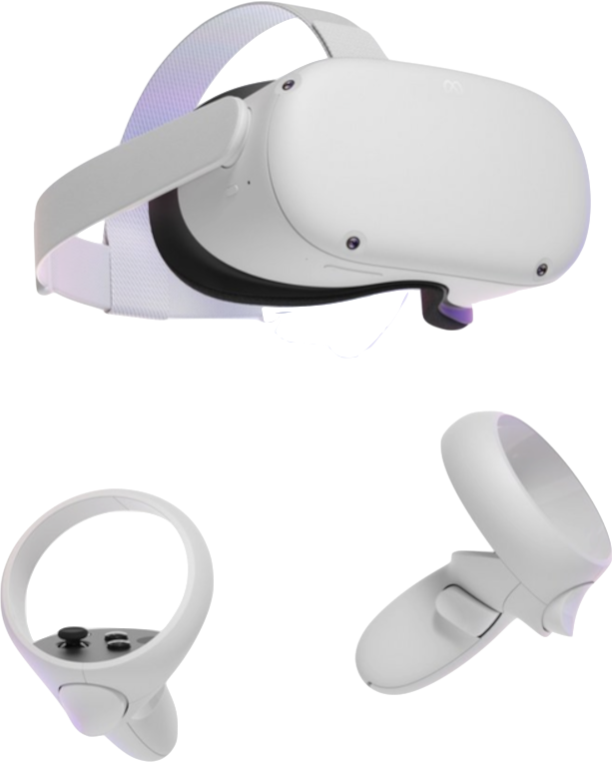
System Overview
<Lecture Slides, Prof Tian>
Visual & Audio
Virtual World Generator
First-Person View

Slide 4
Different Scenes
System Overview
Basketball
Carrier Room
Island
Shooting

Slide 5
System implementation
3D World
{
Enable Movement
Physics
Script
Detect Collision
Instantiate New Object
Effect (Particle, Audio…)

Slide 6
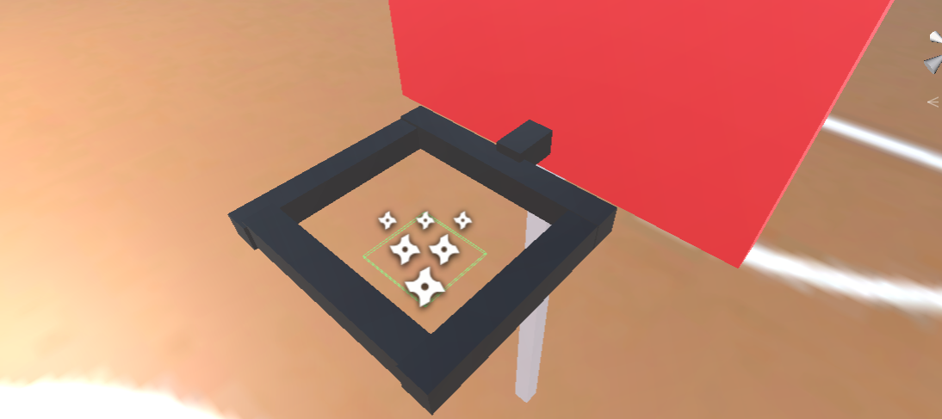
Basketball Scene Implementation
In this game, you can left-click to throw the basketball. I set a score area in the hoop, which can detect the ball flying into it.

Slide 7
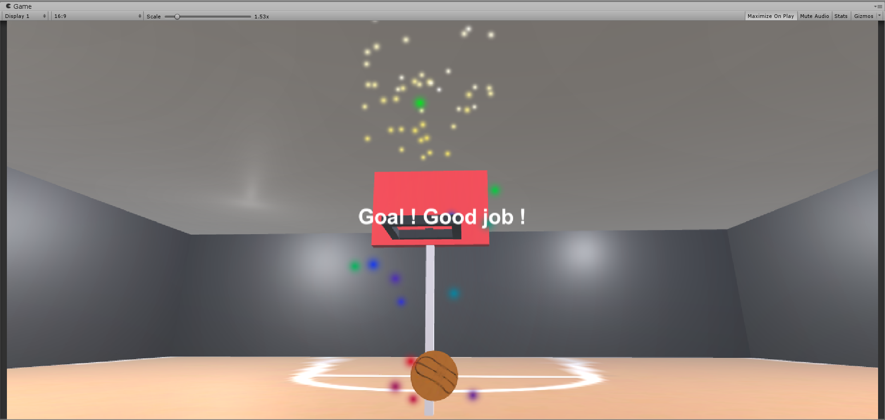
Basketball Scene Implementation
So, you can throw the basketball again and again until the ball hit the score area, then you can see the particle system effect and congratulation text.

Slide 8
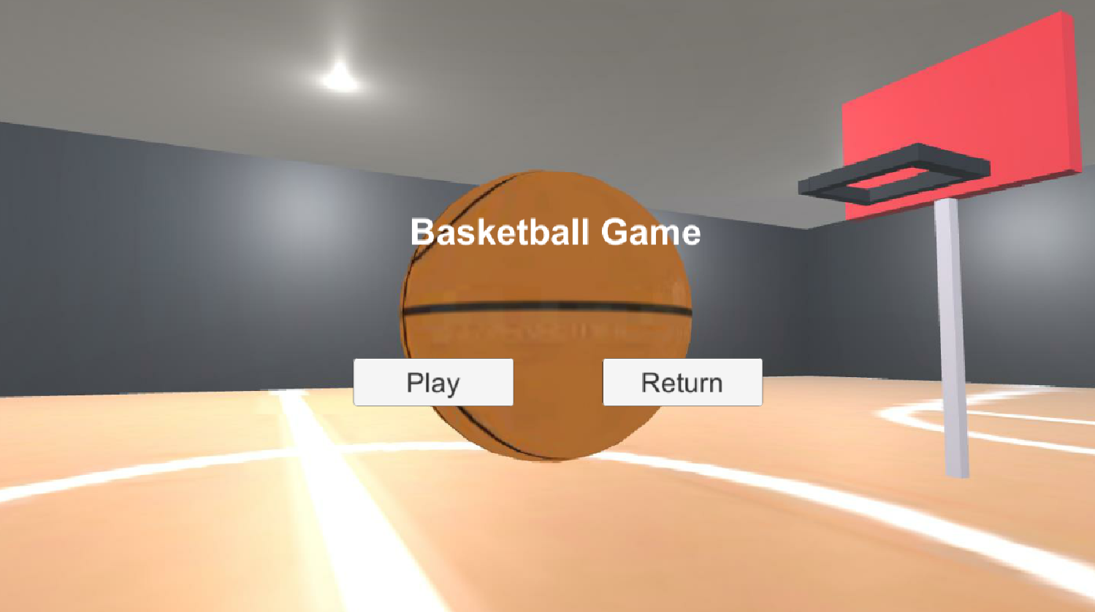
Basketball Scene Implementation
After 5 seconds, it returns to the menu, then you can choose to start a new round or return to the starting room.

Slide 9
Basketball Demo

Slide 10
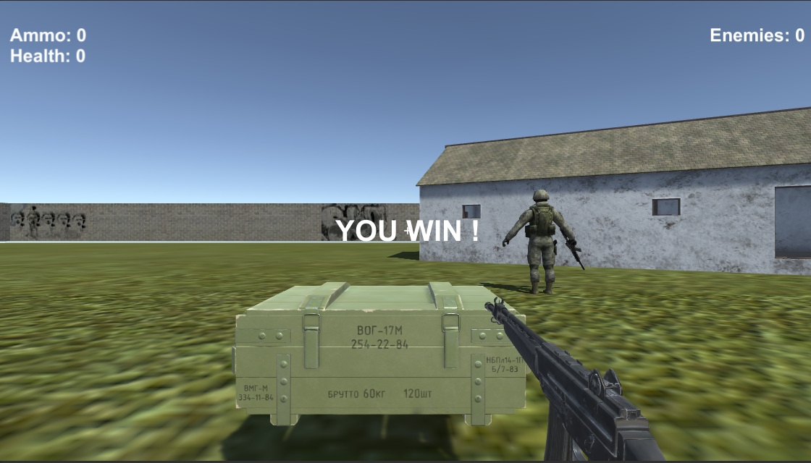
Shooting Scene Implementation
UI – FPS Interface

Slide 11
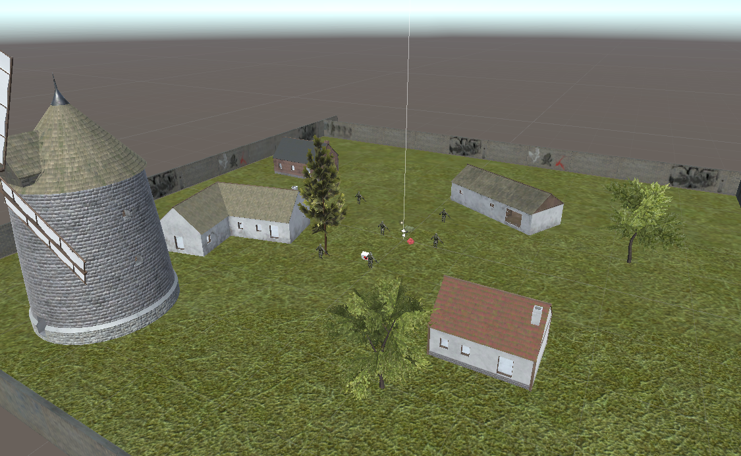
Shooting Scene Implementation
Scene – Playground

Slide 12
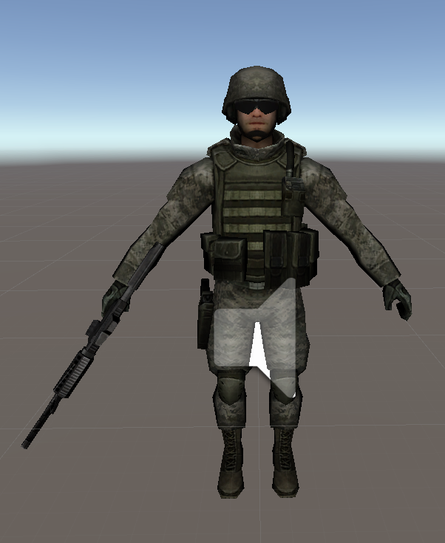
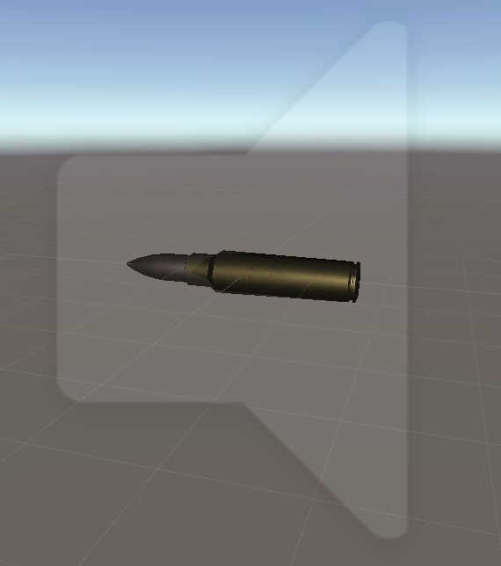
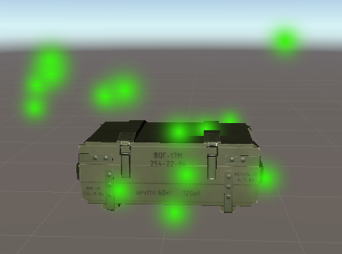
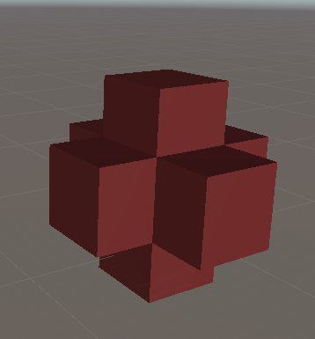
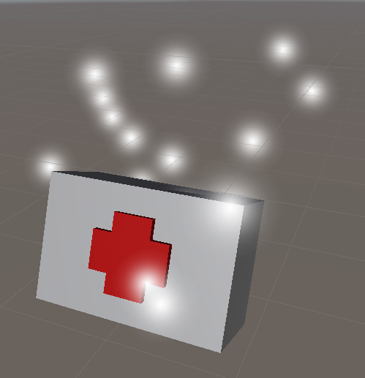
Shooting Scene Implementation
Interactable Components

Slide 13
Shooting Demo

Slide 14
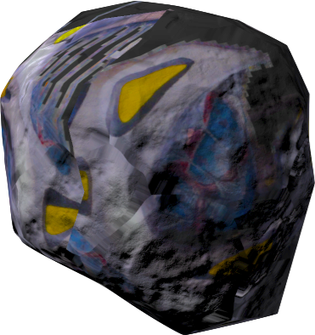
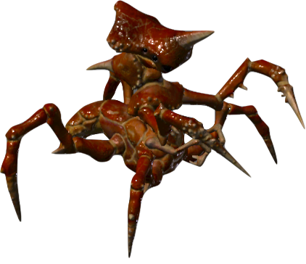

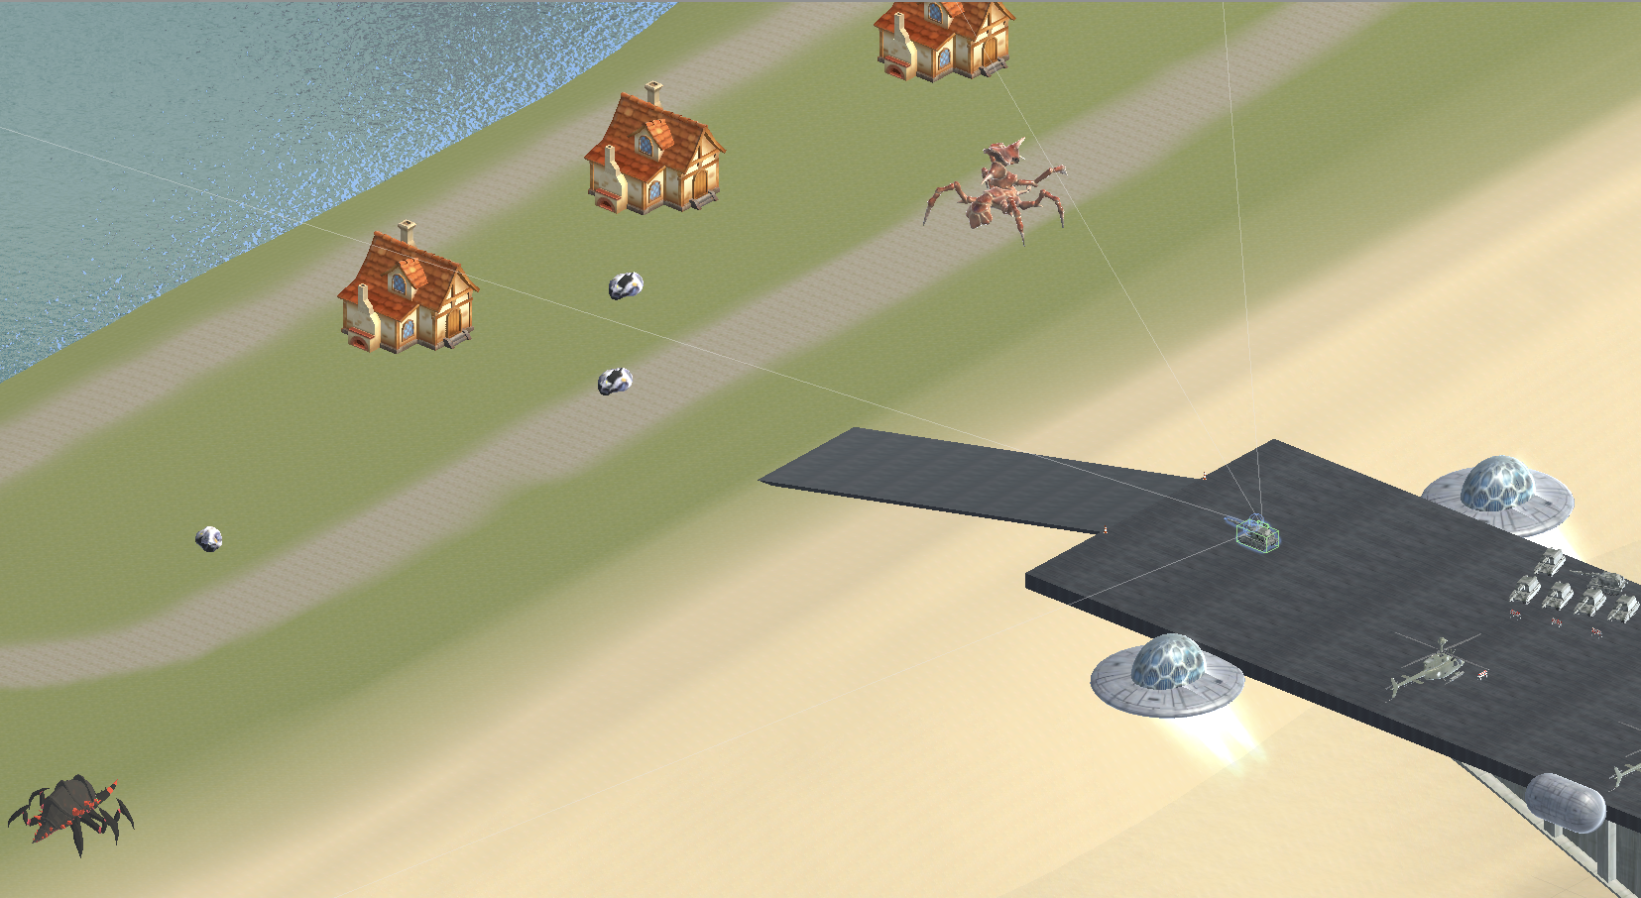
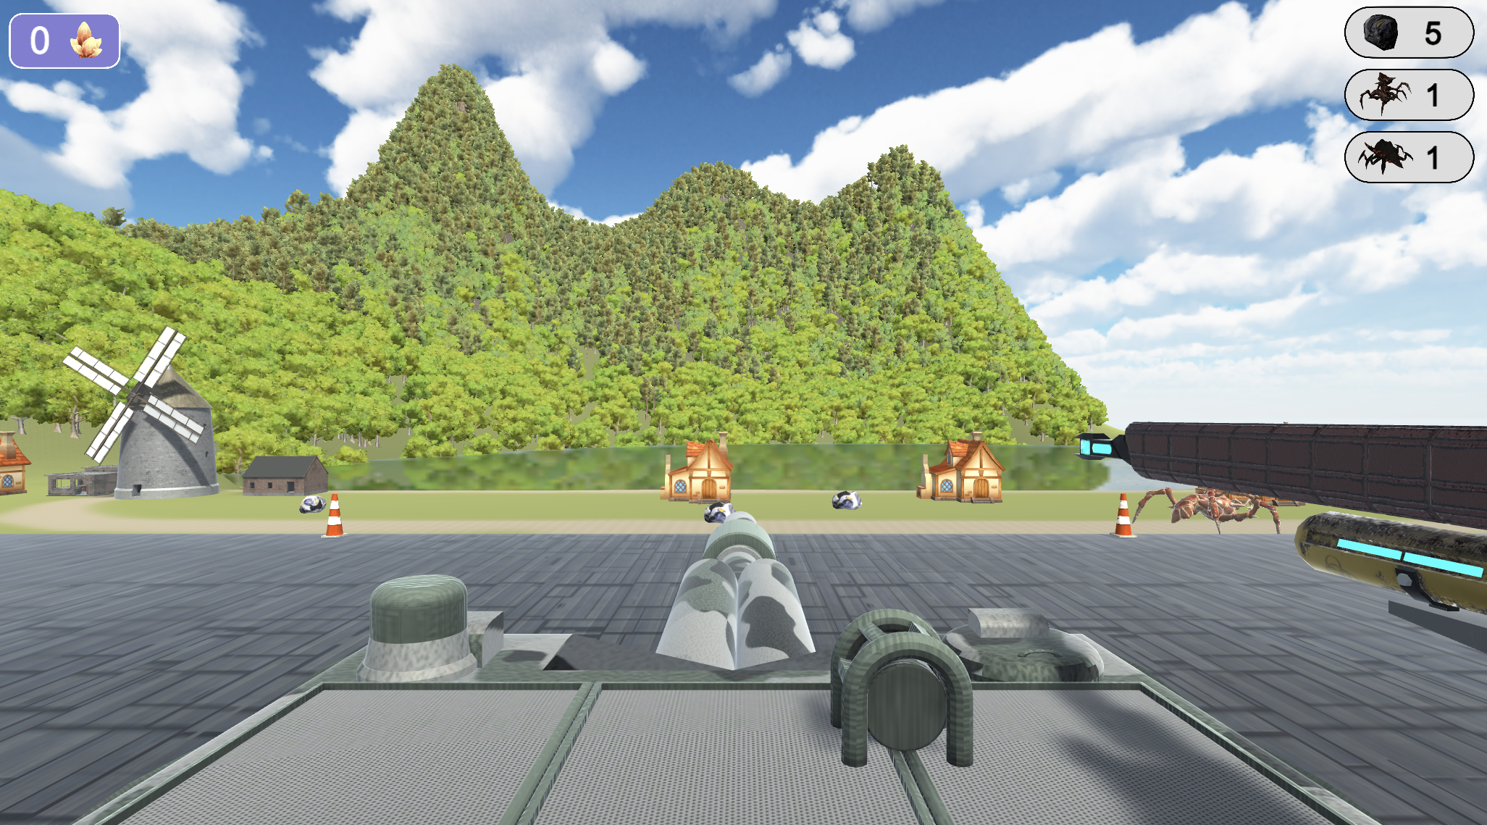
Island Battle Implementation

Slide 15
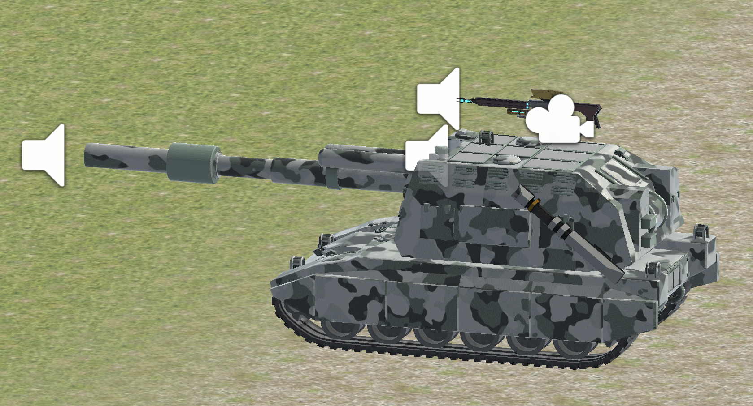
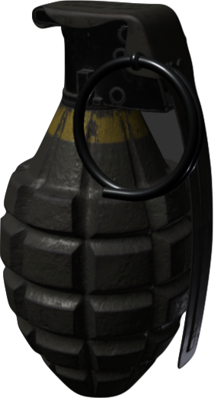
Island Battle Implementation

Slide 16
Island Battle Demo

Slide 17
Future Work
1. More Aesthetics
2. Different Difficulty Levels
3. Precision Improvement (Radar)

Slide 18
Q & A

